Slide 1

Project Review-4
(Final Review)
Front-End Development Frameworks | Fitness Tracker with Weekly Summary |
T.Hasini Sivaram, P.Rahini Sai, N.Suvidha Sree | 2410030193, 2410030347,2410030145 |
Ms.P. Sree Lakshmi | CSE

Slide 2
Introduction
Problem Statement
Users find it difficult to visually organize and track events, deadlines, and schedules using existing timeline and calendar tools. Current platforms are either static, lack interactivity, or do not support custom event triggers, reminders, and hybrid timeline–calendar views. No single solution provides an easy, responsive, and dynamic way to manage time-based activities effectively.
Proposed Solution
ChronoFlow is a web-based interactive timeline system that allows users to create, manage, and visualize events with custom triggers such as reminders, color changes, and animations. It combines timeline flow with a calendar layout, supports event categorization, and delivers a responsive, user-friendly interface across all devices. The platform offers a simple yet powerful way to plan, track, and interact with time-based data.
Developed using
HTML5, CSS3, JavaScript, Flask (Python), MongoDB, and modern UI enhancements

Slide 3
Accuracy of results
Accurate Event Handling – Events are saved, updated, and displayed correctly in real time.
✔ Smooth Data Retrieval – MongoDB fetches event data quickly without errors.
✔ Responsive UI – Timeline animations, scrolling, and theme switching work smoothly on all devices.
✔ Reliable Triggers – Reminders, color changes, and animations activate correctly when events occur.
✔ Stable Authentication – Signup and login work consistently with valid user credentials.
✔ No UI Breakages – Layout adjusts cleanly across mobile, tablet, and desktop without overlapping elements.
✔ Fast Loading – Timeline and dashboard load in under a second for normal event data.

Slide 4
Technical Competence
✔ Modern Front-End Stack
HTML5, CSS3, and JavaScript used to build a fast, responsive, and interactive timeline UI.
✔ Clean UI & Animations
Custom CSS transitions, modal components, theme switching, and event animations enhance user experience.
✔ Robust Back-End
Flask (Python) handles secure API communication for login, signup, and event management.
✔ Real-Time Functionality
Dynamic event rendering, instant timeline updates, and smooth data fetch using Fetch API.
✔ Responsive Design
Timeline and dashboard layouts adapt perfectly across mobile, tablet, and desktop screens.
✔ Secure Authentication
User credentials verified with backend validation and protected database access.

Slide 5
Innovative & Suitable Features
✔ Interactive Timeline System
Visually engaging event flow with animations, color cues, and custom triggers.
✔ Hybrid Timeline + Calendar View
Combines visual chronological layout with structured calendar scheduling.
✔ Smart Event Management
Easy creation, editing, deletion, and categorization of events for better organization.
✔ Personalized UI Experience
Theme switching, category filters, and clean layouts tailored to user preferences.
✔ Real-Time Updates
Events appear instantly with smooth transitions and live data retrieval from MongoDB.
✔ All-in-One Organization Tool
Replaces multiple timeline and reminder apps by offering visualization, reminders, triggers, and filtering in one platform.

Slide 6
Utility to Society
✔ Improves Time Management Skills
Helps users visually organize tasks, deadlines, and events, enabling better planning and productivity.
✔ Accessible to Everyone
Works on any device without restrictions—no platform lock-in, no premium-only limitations, fully web-based.
✔ Enhances Awareness & Discipline
Encourages users to stay consistent with schedules by providing reminders, visual cues, and interactive triggers.
✔ Useful for Students, Professionals & Educators
Supports academic planning, project timelines, meeting schedules, and personal life management—all in one simple tool.
✔ Supports Better Organization Habits
Reduces confusion and missed deadlines by offering a clear, interactive, and intuitive timeline view.

Slide 7
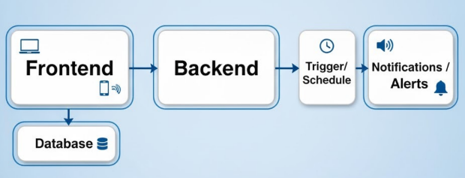
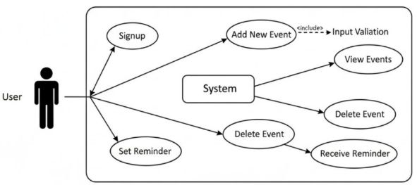

Slide 8
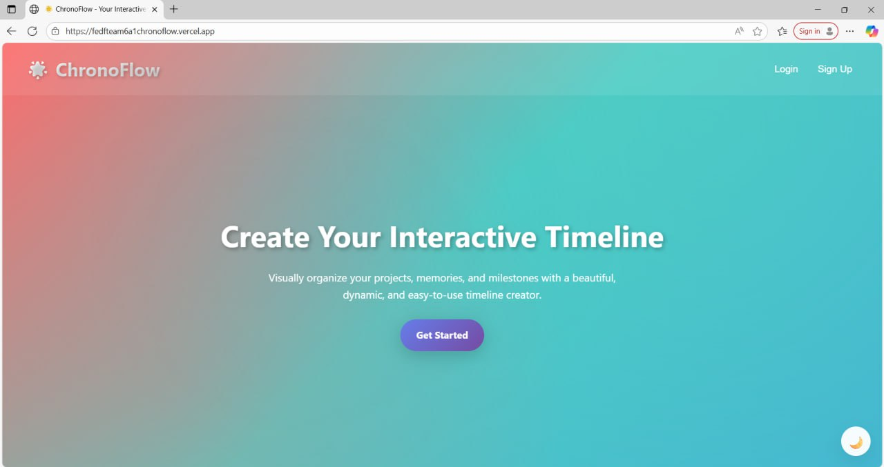
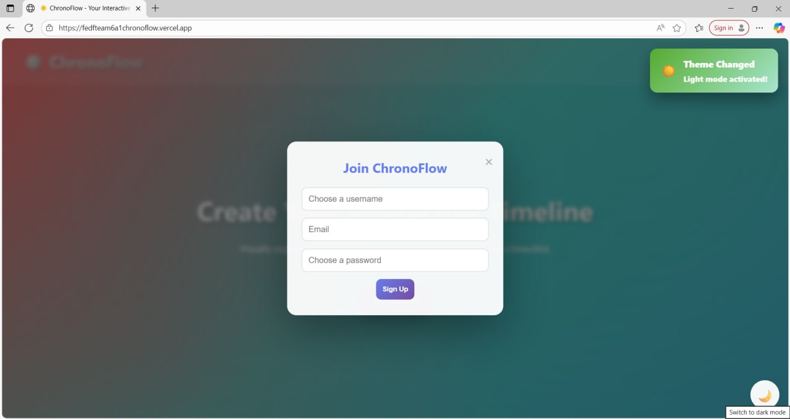
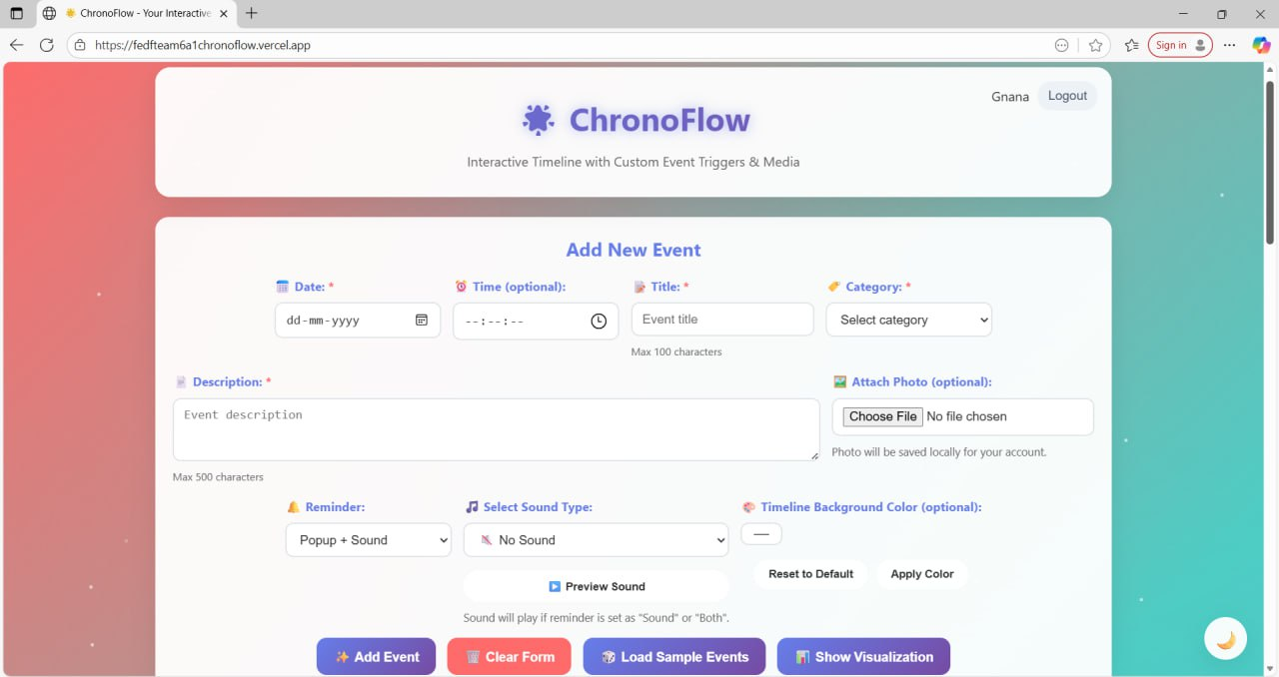
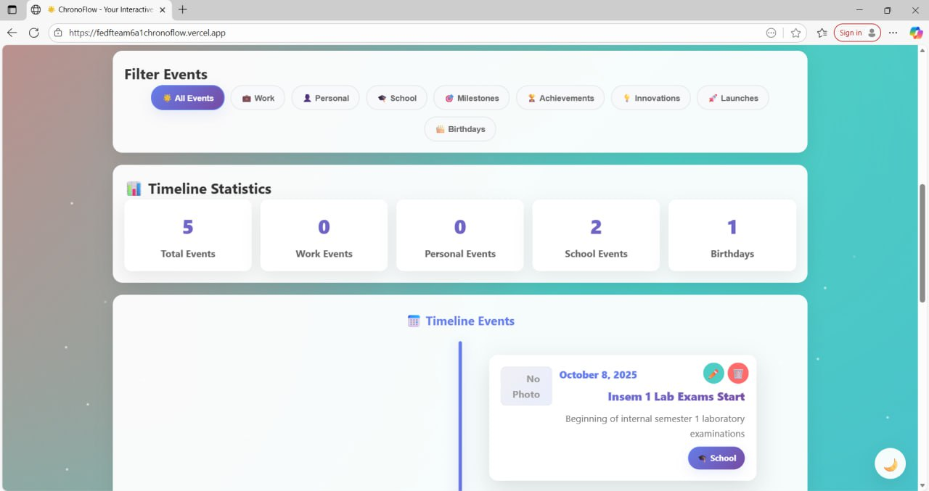

Slide 9
THANK YOU

